Slide 1


Visual Data Science
Andrea Julca College of Information Studies University of Maryland, College Park

Slide 2

MOTIVATING QUESTIONS:

Slide 3
OUTLINE
Defining data science
Extract, transform, load (ETL)
Exploratory analysis and modeling
NLP – Natural Language Processing
Streaming visualization

Slide 4
What is a "data scientist?"
"Data Scientist (n.): Person who is better at statistics than any software engineer and better at software engineering than any statistician." - Josh Wills
Something of a marketing term, but careers and formal data science programs have sprung up around the concept

Slide 5
Exploratory Data Analysis (EDA)
Model
Based on Tukey, J.W. The Future of Data Analysis. 1962. and Exploratory data analysis. 1977.
Summarize
Tabulate
Acquisition
EDA
Hypotheses
Graph

Slide 6
Data science competencies
Anderson et al. (2014):
Information retrieval
Large or streaming data sets
Databases
AI and statistical techniques
Software development and algorithms
Mathematics
Communication
Social, ethical, and legal awareness

Slide 7
Data science competencies
Anderson et al. (2014):
Information retrieval
Large or streaming data sets
Databases
AI and statistical techniques
Software development and algorithms
Mathematics
Communication
Social, ethical, and legal awareness

Slide 8
Data science competencies
Anderson et al. (2014):
Information retrieval
Large or streaming data sets
Databases
AI and statistical techniques
Software development and algorithms
Mathematics
Communication
Social, ethical, and legal awareness

Slide 9
Data science workflow
Scope out the problem or question
Knowledge search: Research and sensemaking
Data retrieval; extract, transform, load (ETL)
Exploratory analysis
Modeling
System-building [sometimes]
Versioning/archival
Communication

Slide 10
Data science workflow
Scope out the problem or question
Knowledge search: Research and sensemaking
Data retrieval; extract, transform, load (ETL)
Exploratory analysis
Modeling
System-building [sometimes]
Versioning/archival
Communication

Slide 11
Extract: Information retrieval
Information systems: Get data from a database
Information studies: "Everything is data"
Tables
Text
Images
Media files (video, audio)
Interviews?
Artifacts??
Other examples?

Slide 12
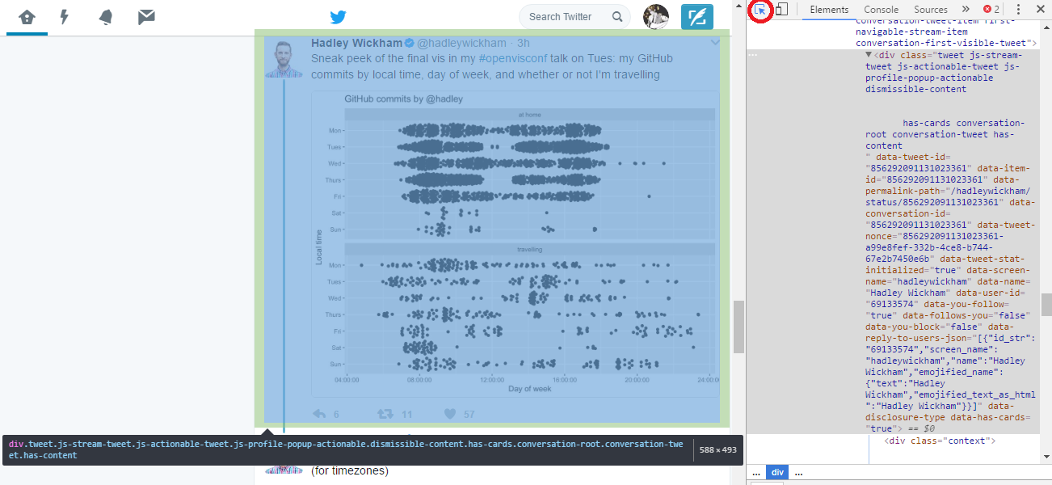
Extract: "Webscraping"
Windows: F12, Ctrl + Shift + I Mac: Cmd + Opt + I

Slide 13
Transform [Info Systems]
Reshaping and restructuring data for the target database
Clean
Filter
Apply models
Business rules
Aggregate
Et cetera

Slide 14
Transform [Mathematics]
Geometry:
Reflect
Rotate
Scale (resize)
Translate (shift position)
Generally:
An invertible function mapping one domain to another

Slide 15
Transform [Comp & Data Sci]
Why not both?

Slide 16
Data science workflow
Scope out the problem or question
Knowledge search: Research and sensemaking
Data retrieval; extract, transform, load (ETL)
Exploratory analysis
Modeling
System-building [sometimes]
Versioning/archival
Communication

Slide 17
[demonstration]

Slide 18

In-Class Exercise 1
Use R with "rvest" package to extract data from website of your choice
Use "tidytext" package to transform into tibble
See "Scrape.R" @https://goo.gl/z6OqUS

Slide 19
Load (Stage/Publish) & Archive
We've "loaded" the data from our chosen website into the R environment
Not a reliable way to warehouse. Why? Low permanence
Also not a great publication / communication platform
In a more complete information or business system, we would:
Perform further transformations
Load into database with well-defined schema (higher permanence)
We're skipping that today

Slide 20
Data science competencies
Anderson et al. (2014):
Information retrieval
Large or streaming data sets
Databases
AI and statistical techniques
Software development and algorithms
Mathematics
Communication
Social, ethical, and legal awareness

Slide 21
Streaming Visualization
What is "streaming?"
Transfer of continuously-generated data in real time
"Real-time" somewhat subjective, contextual
"Streaming visualization," then, is any vis that is continuously updated based on newly-generated, high frequency data

Slide 22
Our process so far & next step
Site
Transform
Model
Publish
[Stage]
Extract

Slide 23

In-Class Exercise 2
Download index.html, Bind.R, and serve.R from https://goo.gl/z6OqUS
Change "outDir" (Bind.R) and "rootDir" (serve.R)
Run bind.R
Run serve.R
Explain what's happening to the data

Slide 24
Our finished network of continuous processes
Source
Site updated?
Get list of data files in archive
NLP + Regression
Yes
Update vis
Update Archive
(JSON in “/data”)
Serve JSON files
Extract
Update Tibble
Create vis
Get latest file on list
= Craigslist
= R1
= R2
On init
= D3 JS/CSS/HTML Vis

Slide 25
Data science workflow
Scope out the problem or question
Knowledge search: Research and sensemaking
Data retrieval; extract, transform, load (ETL)
Exploratory analysis
Modeling
System-building [sometimes]
Versioning/archival
Communication

Slide 26

CLOSING
REMARKS

Slide 27
QUEST IONS .

